Slide 1
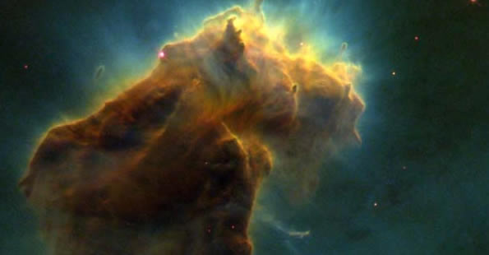
Chapter 3 Section 5 Lives of Stars

Slide 3
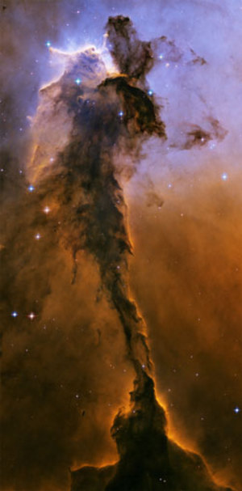
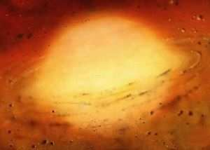
Star Life Cycle
Eagle Nebula
7,000 Light Years away
The mass and composition determines everything about a star.
Stars are not burning!
Nebula- cloud of dust and gas that starts to heat up and condense
Protostar- expands after condensing and fusion begins
A protostar may last from 100,000 to 10 million years

Slide 4
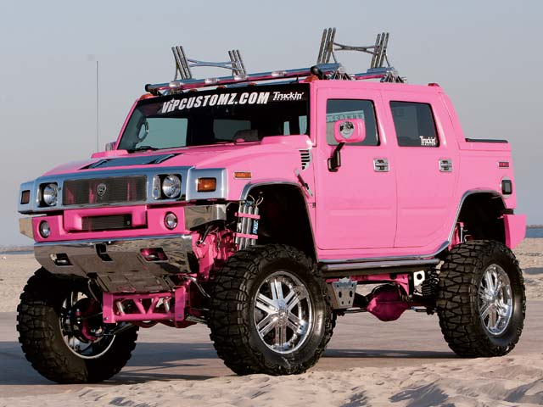
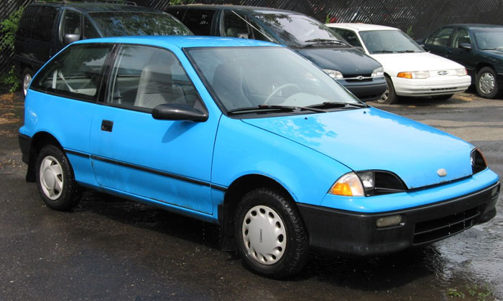
Star Life Cycle
3. Main sequence star- most of a star’s lifetime is spent as a main sequence star (90 % of stars)
-Our sun can be found here and is considered to be a yellow dwarf
Remember: A STAR’S MASS WILL DETERMINE WHAT IT WILL BECOME
4. Average/Small Star- will become a red giant
Will it live a long or a short life? How do you know?
VS.

Slide 5
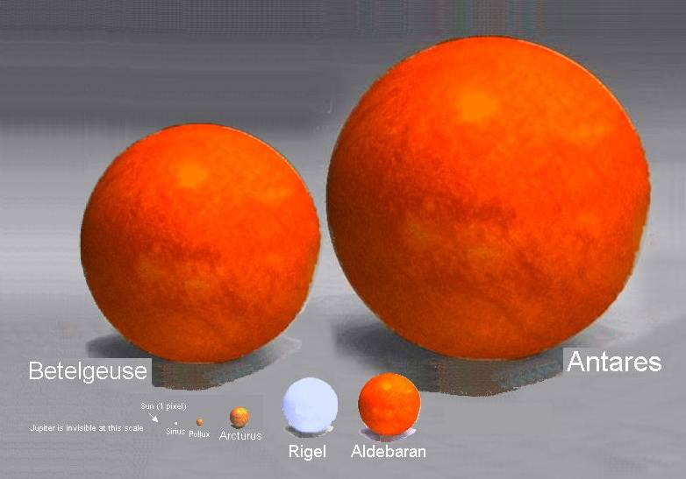

Slide 6
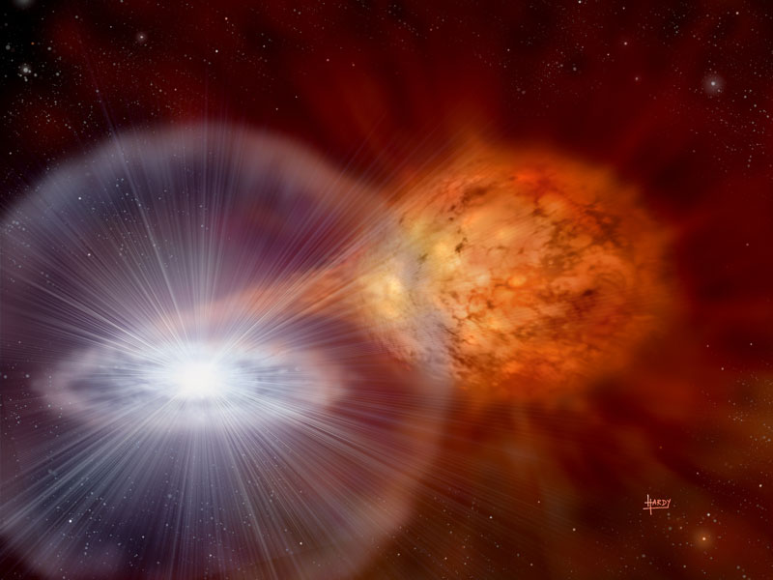
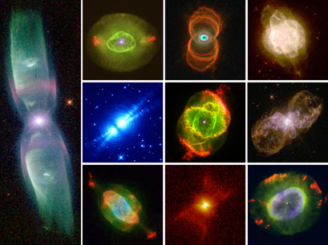
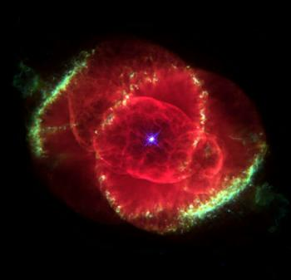
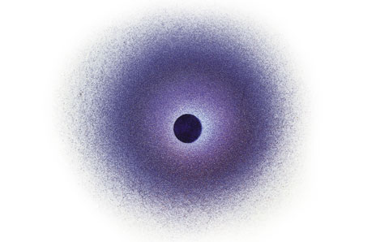
Star Life Cycle
Binary Stars: white dwarf and red giant
5. Red Giant- will burn fuel slower and live longer
6. Runs out of fuel and blows away atmosphere
7. Planetary Nebula- the star’s core is the only thing left
8. Cooling white dwarf (it reddens as it cools)
9. Black Dwarf- stops glowing
Various planetary nebulae
Cat Eye Nebula w/ a white dwarf in the center
Black Dwarf

Slide 7
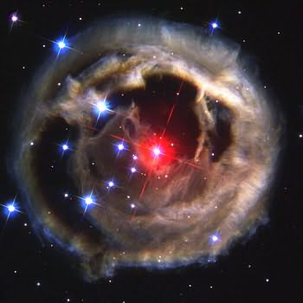
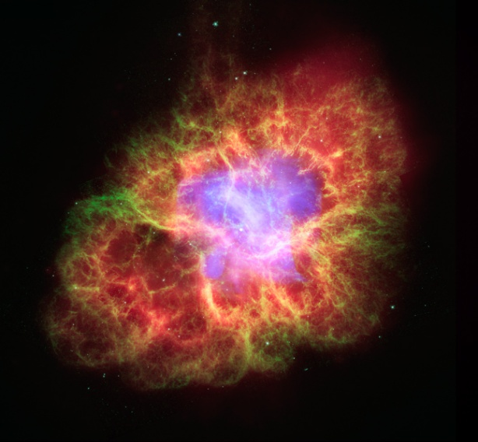
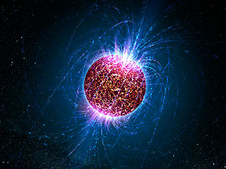
Star Life Cycle
Red supergiant Moncerotis
4. Massive stars become supergiants
5. Supergiants- burn fuel faster and therefore have a shorter life.
6. Supernova- begins running out of fuel which causes a massive explosion in which it blasts away its outer layers.
7. A medium-large star
8. Neutron Star- it can’t support its own density and collapses on itself (these stars are about 1.4 X’s the size of our sun)
Supernova in the Tarus constellation that began hundreds of thousands of years ago
Neutron Star near Earth-one tsp. of its dust weighs millions of tons

Slide 8
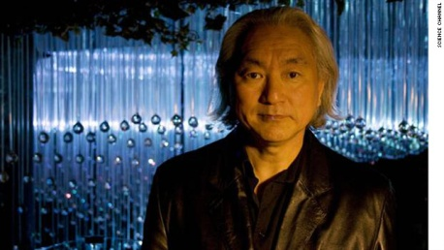
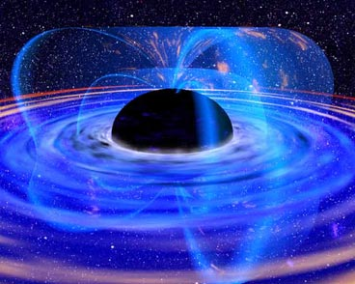
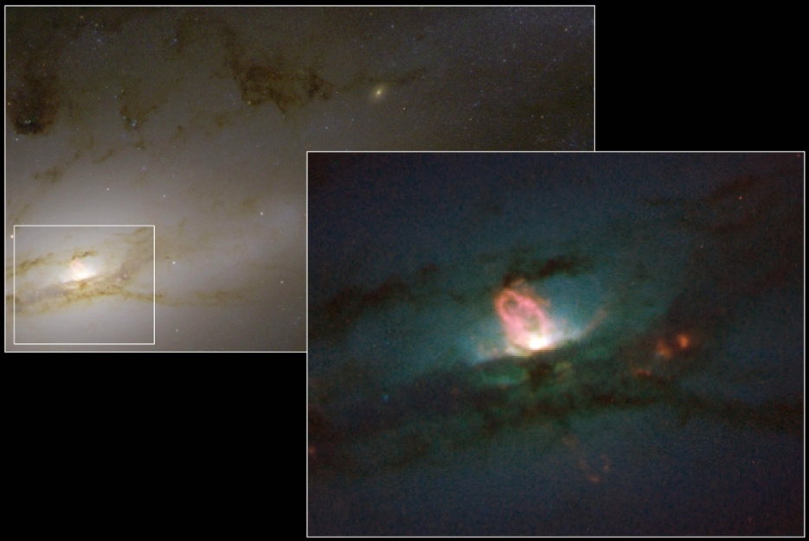
Star Life Cycle
7. OR, if the star is HUGE the core collapses and the atoms are so tightly condensed that the dead star literally disappears
8. What is left is an intense region of circling gravity = a Black Hole
- Nothing can escape a black hole, even light
-Only stars that are 3 X’s the size of our sun can potentially become a black hole

